Slide 1
Project 4
Hiring Process Analytics
Hyperlink to the Excel Sheet:
https://docs.google.com/spreadsheets/d/1LXZf39WTNyTIxg-0696KW4qFjZpVAXhB/edit?usp=sharing&ouid=111775799564275591184&rtpof=true&sd=true
* Please open the presentation and excel sheet in Microsoft software as opening in Google is changing the layout and plots *

Slide 2

Project Description
This Project is about giving insights about Hiring Process based on data provided.
These insights will be helpful for hiring department to improve its hiring process.
As a Data Analyst, we received dataset containing records of previous hires and questions and we are required to analyze the data and provide insights to those queries.
To do this, we will use Microsoft Excel software to extract and filter data from the dataset provided and analyse them to get the required insights.
Image Source: Google Images

Slide 3

Approach
We had received a dataset containing information related to Hiring process like applicant ID, date of interview, hired or not, gender of candidate, department and post of vacancies, salary offered.
We first tried to understand the whole dataset.
Then we performed Data Pre-Processing where we checked and did necessary changes for missing data, error in data, outliers in data and duplicates in data especially for applicant ID.
Then we directly started filtering data as per the questions we had. We also plotted some graphs for better understanding. Then we drew conclusions and insights based on the filtered data and the plots.
Now, since we got all the insights required, we will make a detailed report about it and hand them over to the hiring department.
Image Source: Google Images

Slide 4

Tech-Stack Used
Microsoft Excel 2021– A spreadsheet editor software used mainly by professionals to enter data in table format, perform computations, plot graphs etc. Here Microsoft Excel is used to filter data and plot graphs to get insights about hiring process of the organization.
Image Source: Google Images

Slide 5
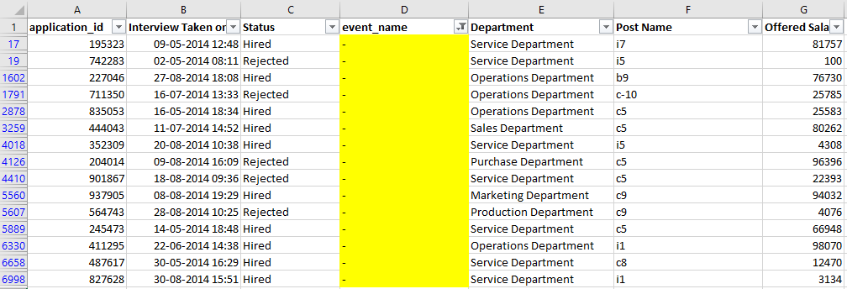
Data Pre-Processing
Handling Missing Values
A. Column event_name has 15 rows with “-“ as its values. It can be termed as Null value. We replaced it with “Don’t want to say” as they both implies the same thing in context of this project i.e. gender of the candidate is not known.

Slide 6
Data Pre-Processing
Handling Missing Values
B. Column Offered Salary has 1 row with Null Value. The corresponding value in Department column is “Sales Department” and Post Name is “i7”. So we replaced it with median of Offered Salary for Sales Department and i7 Post Name. The median came out to 45400.

Slide 7
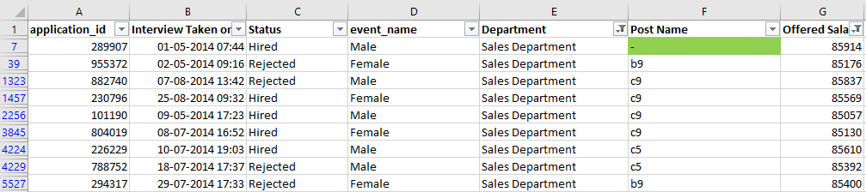
Data Pre-Processing
Handling Missing Values
C. Column Post Name has 1 row with “-“ as its value. It can be termed as Null value. The corresponding value in Department column is “Sales Department” and Offered Salary is “85914”. So we replaced it with majority count of Posts for candidates in Sales Department and whose Offered Salary is between 85,000 and 96,000, which is “c9”.

Slide 8
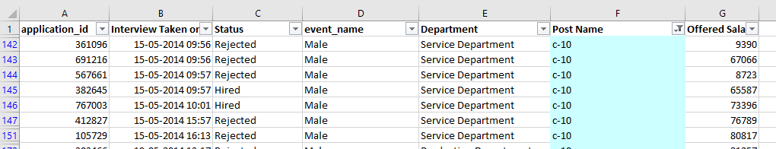
Data Pre-Processing
Rectifying Error in Column Values
Column Post Name has a category “c-10” which seems to be a typo and the correct category should be “c10” which we rectified.

Slide 9
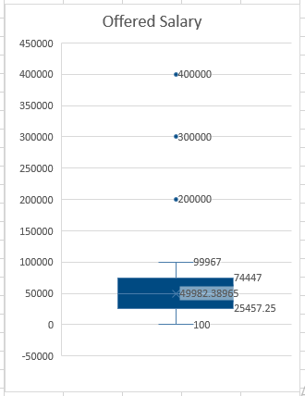
Data Pre-Processing
Detecting and Removing Outliers
From the below Box Plot of Column Offered Salary, we can see that there are three rows whose Column values are outliers and the values are 200000, 300000, 400000. We can replace them with median value of Offered Salary for corresponding Department and Post Name.

Slide 10
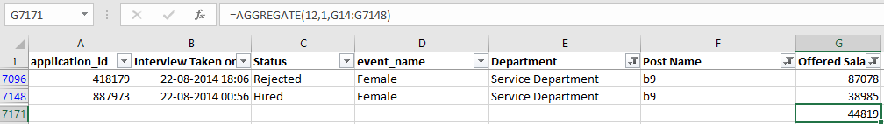
Data Pre-Processing
Detecting and Removing Outliers
For the Offered Salary value of 200000.

Slide 11
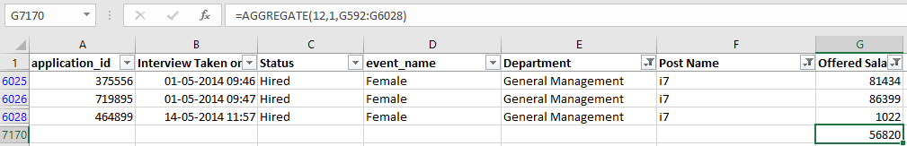
Data Pre-Processing
Detecting and Removing Outliers
For the Offered Salary value of 300000.

Slide 12
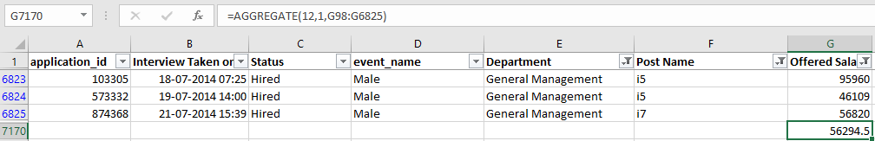
Data Pre-Processing
Detecting and Removing Outliers
For the Offered Salary value of 400000. Here Post Name i4 has only one row, so we considered all rows with Post Name value starting with “i”. We have rounded up the value to 56295 in the excel sheet.

Slide 13
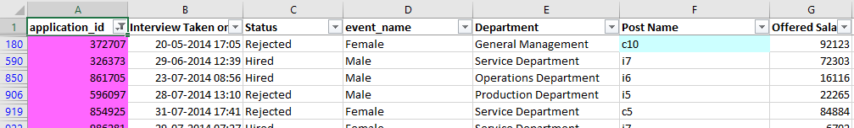
Data Pre-Processing
Identifying Duplicate Values in application_id
Column application_id has 54 rows with duplicate values. They should either be removed or replaced with correct value. Here we are just highlighting the cells having duplicate values.

Slide 14
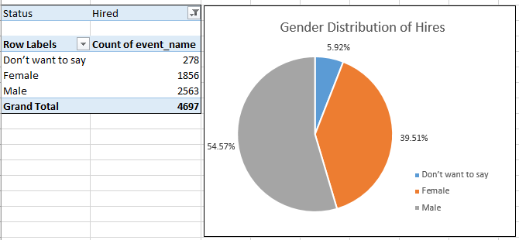
Insights
A. Hiring Analysis: The hiring process involves bringing new individuals into the organization for various roles.
Task: Determine the gender distribution of hires. How many males and females have been hired by the company?
Result:
Insight:
More than half of the hired candidates are Male and only 39.51% of them are Female. The rest haven’t disclosed there Gender. High Gender Ratio (Ratio of Male to Female) may negatively impact the Organization’s image in Public domain. The Organization should therefore focus on decreasing the Gender Ratio bringing it close to 1.
The Data Quality Team should ensure that the Data is complete and relevant as incomplete or irrelevant data may hamper the analysis process.

Slide 15

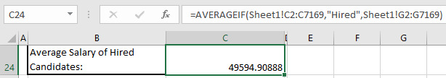
Insights
B. Salary Analysis: The average salary is calculated by adding up the salaries of a group of employees and then dividing the total by the number of employees.
Task: What is the average salary offered by this company? Use Excel functions to calculate this.
Result:
Insight:
The Average Offered Salary is Currency-Unit 49878.86 and the Average Salary of Hired Candidates is Currency-Unit 49594.91.
The Average Salary of Hired Candidates is almost same as that of Offered Salary. This shows that the hiring team is recruiting candidates as per the pre-determined salary bands of the organization.
Average Offered Salary :
Average Salary of Hired Candidates:

Slide 16
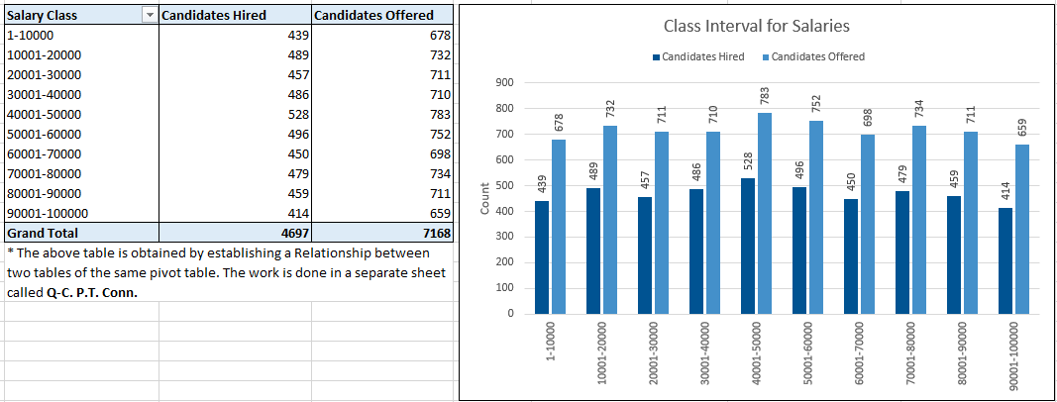
Insights
C. Salary Distribution: Class intervals represent ranges of values, in this case, salary ranges. The class interval is the difference between the upper and lower limits of a class.
Task: Create class intervals for the salaries in the company. This will help you understand the salary distribution.
Result:

Slide 17
Insights
C. Salary Distribution: Class intervals represent ranges of values, in this case, salary ranges. The class interval is the difference between the upper and lower limits of a class.
Task: Create class intervals for the salaries in the company. This will help you understand the salary distribution.
Insight:
We can observe that maximum offered salary is in the interval of Currency-Unit 40001-50000 while minimum offered salary are in intervals of Currency-Unit 90001-100000 and Currency-Unit 1-10000. That is most of the job requirement was for middle experience posts and least for senior most posts and for freshers (assuming salary is directly proportional to work experience).
We can also observe that the distribution of Salaries of hired candidate also follows the same pattern i.e. most candidates hired for middle experience posts and least for senior most posts and for freshers (assuming salary is directly proportional to work experience).

Slide 18
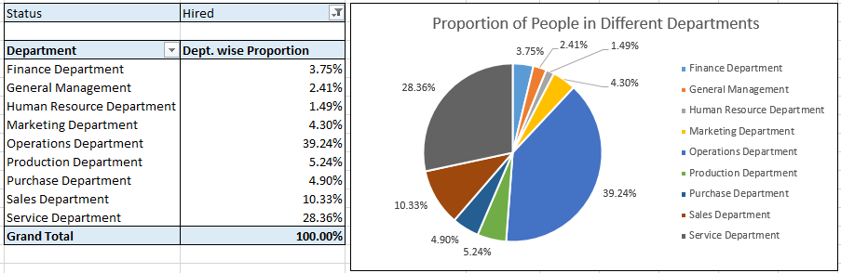
Insights
D. Departmental Analysis: Visualizing data through charts and plots is a crucial part of data analysis.
Task: Use a pie chart, bar graph, or any other suitable visualization to show the proportion of people working in different departments.
Result:
Insight:
From the above pie chart, we can observe that most candidates are hired in Operations Department followed by Services Department and Sales Department and the least candidates are hired in Human Resource Department.
These numbers may indicate the size of teams and importance of the departments in the organization.

Slide 19
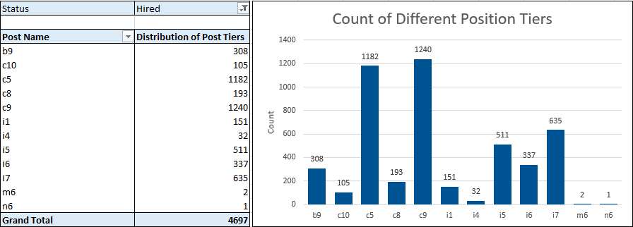
Insights
E. Position Tier Analysis: Different positions within a company often have different tiers or levels.
Task: Use a chart or graph to represent the different position tiers within the company. This will help you understand the distribution of positions across different tiers.
Result:
Insight:
Here, we can observe that the organization has hired most candidates for post tier c9 followed by c5 and then i7 at distant third.

Slide 20

Result
Through this project, I was able to understand how important Data Analytics is for Hiring Process of an organization as it provides valuable insights such as number of rejections, reason for rejections, profile of applicants, vacancies etc. which helps the hiring department to take Data-Driven Decisions.
In this project I was able to get insights about various questions like gender distribution of hired candidates, average salary offered vs. average salary of hired candidates, salary distribution of offered jobs vs. salary distribution of hired candidates, department and post tier wise distribution of hired candidates etc. I also got experience in Data Preprocessing like Data Cleaning in this project as the data required some cleaning. I can communicate the insights to the hiring department as per the requirements using which they can make proper data-driven decisions.
This Project has also helped me in understanding the various functions of MS-Excel and its working.
Image Source: Google Images

Slide 21
Thank You

